Slide 1
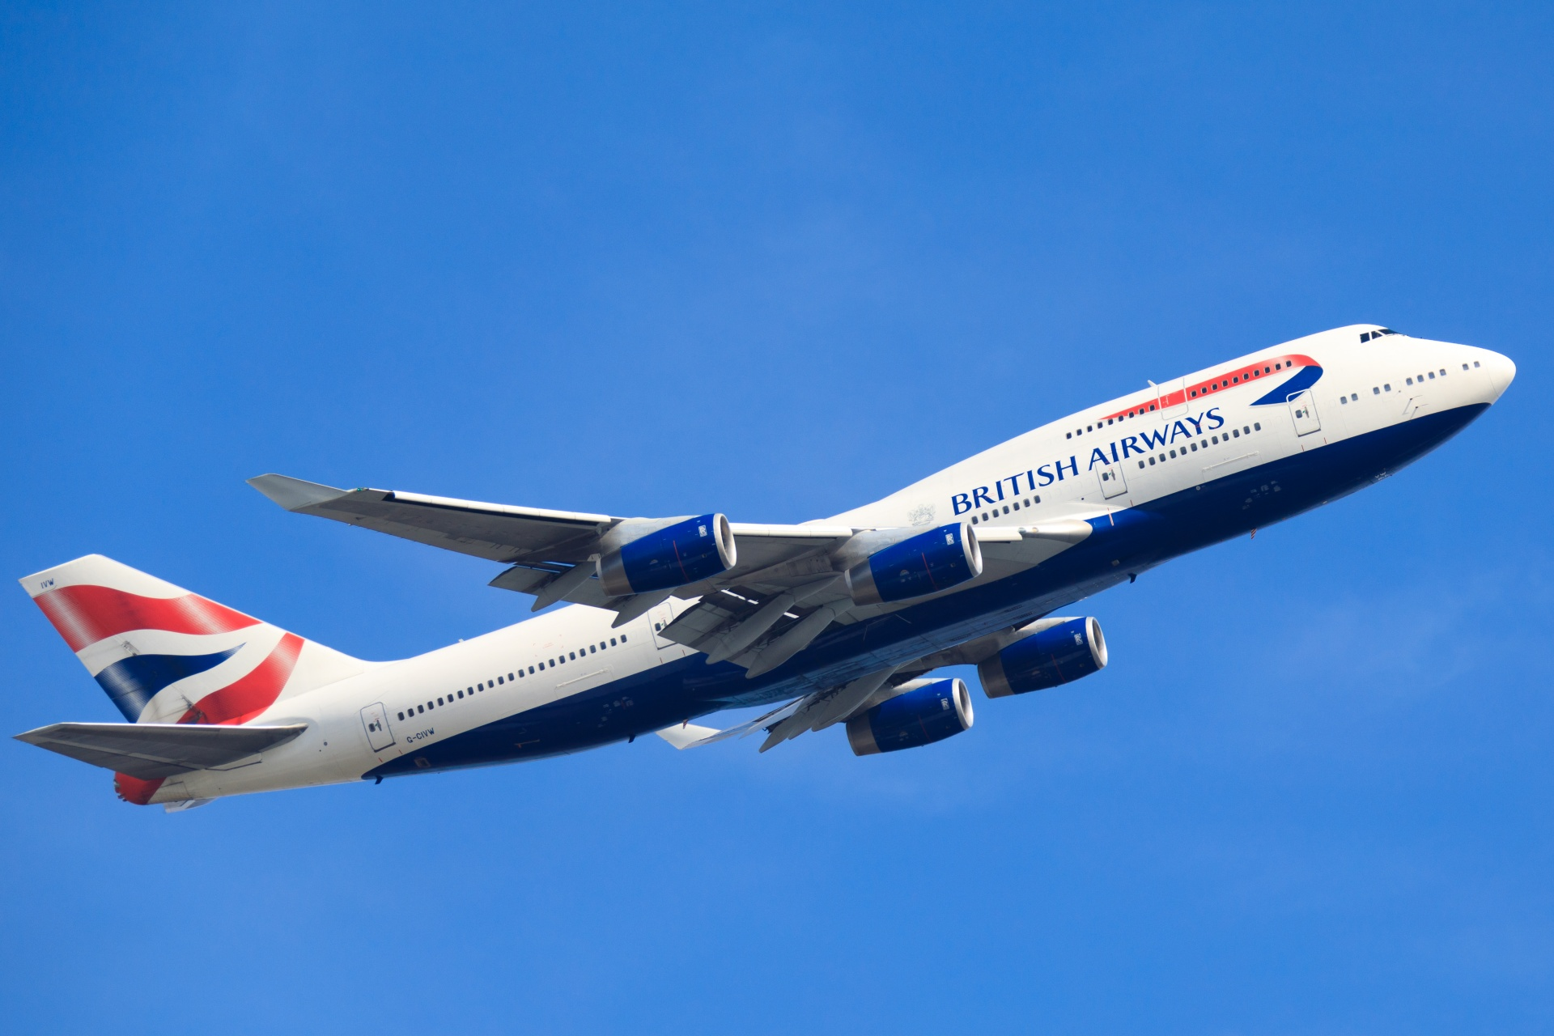
BRITISH AIRWAYS
Customer Reviews Analysis(2018-2023).

Slide 2
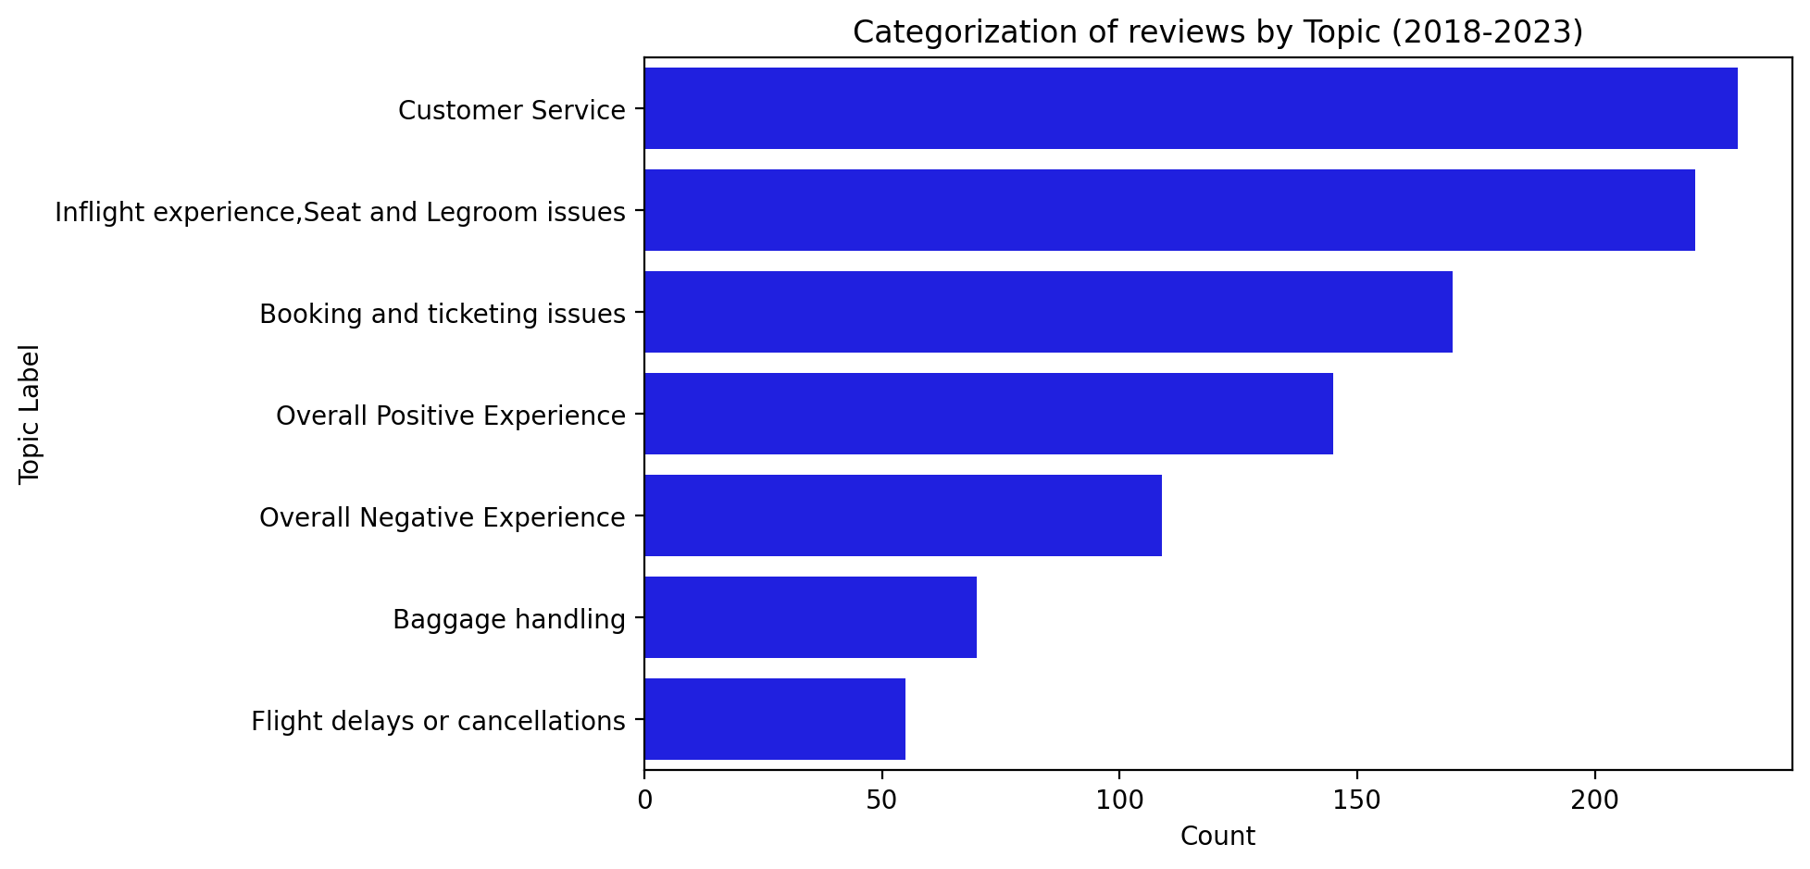
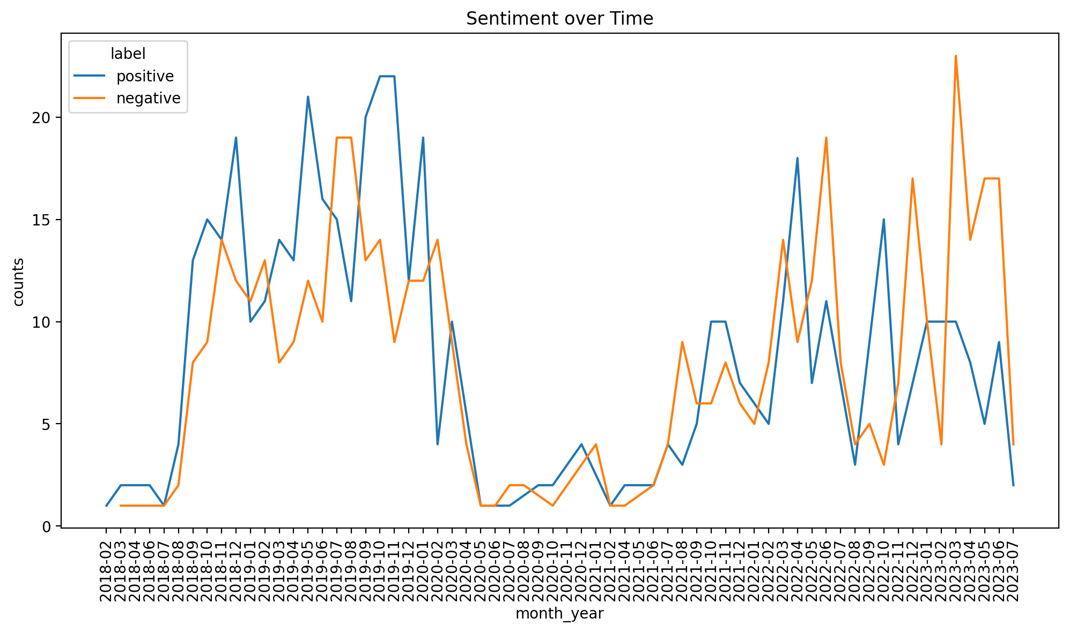
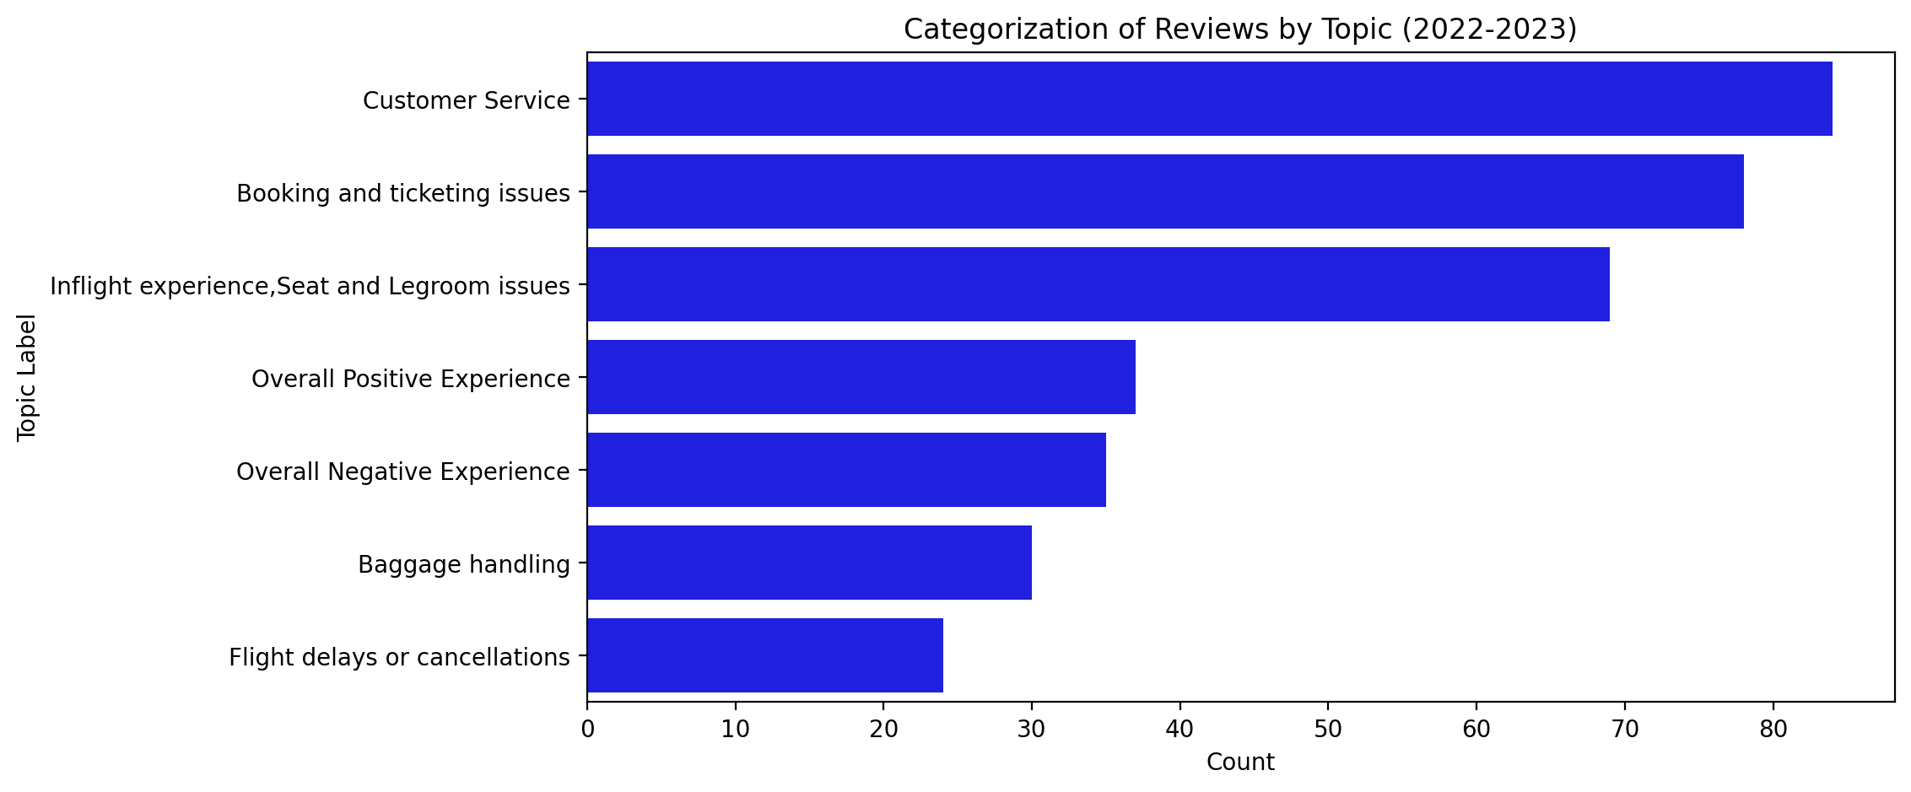
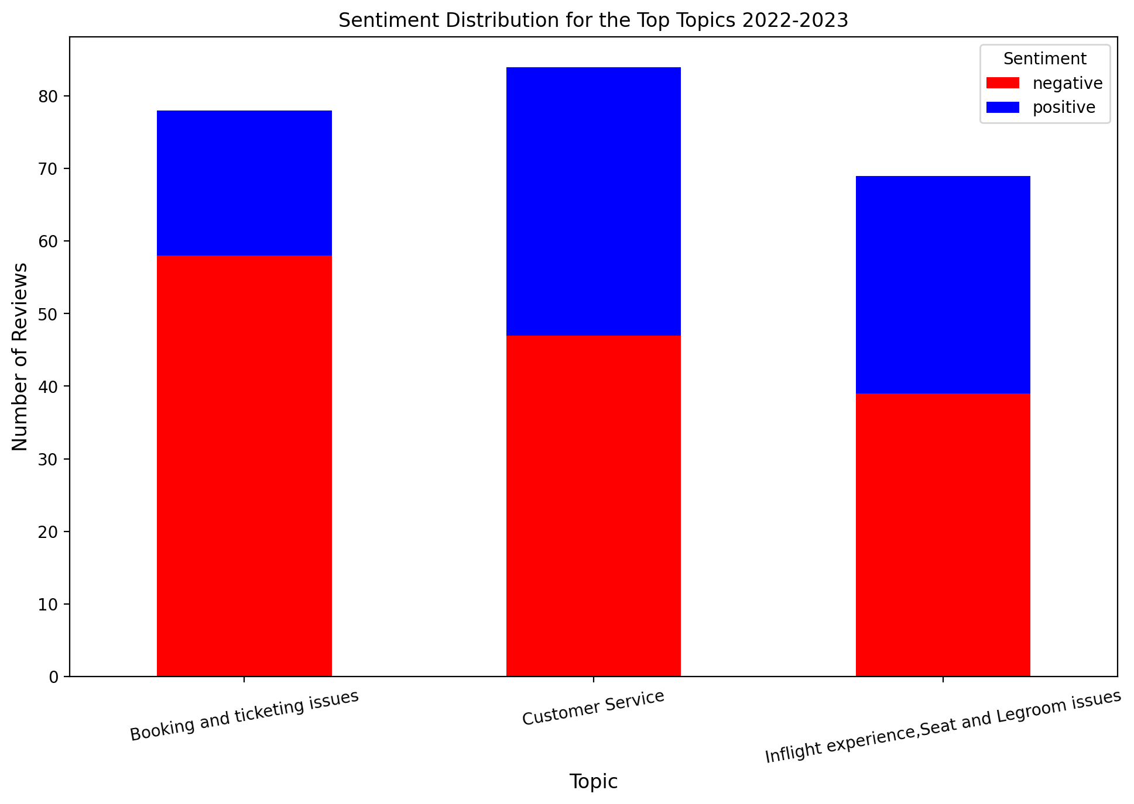
This analysis examines customer reviews for British Airways over a period of six years, culminating in the identification of seven key topics (Fig. 1). While sentiments varied across different aspects of the airline's service, the overarching trend was a notable shift in customer perception, particularly between 2021 and 2023.
Sentiment Over Time: A trend analysis revealed a significant pivot in sentiment starting in 2022. While negative reviews constituted 46% of total feedback from 2018 to 2021, this figure surged to 56% in the subsequent two-year period (Fig. 2). The escalation in dissatisfaction represents a critical transition point warranting further exploration.
Predominant Negative Topics (2022-2023): Among the multifaceted concerns expressed by customers, three topics emerged as the most recurrent, notably:
Booking and Ticketing Issues: A staggering 74% of the reviews in this category were negative, reflecting predominant dissatisfaction with the reservation and ticketing process.
Customer Service & Inflight Experience: Although not as pronounced as booking issues, these areas also manifested substantial negative sentiments.

